Slide 1
NETWORK PROTOCOL

Slide 3
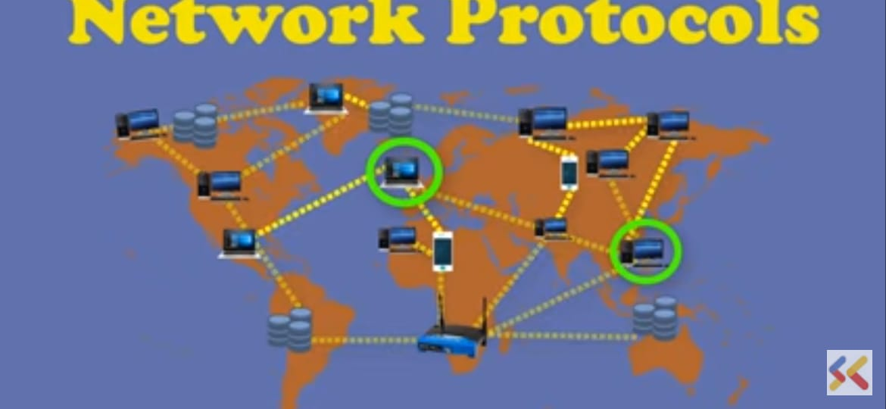
Two computers that connect with each other they have the same language.It should be very well planned and structured to enable it.

Slide 5
It has multiple layers.Each layers has the different protocols for communication within each layer.

Slide 6
Point to Point Protocol It divides the stream of data into shorter pieces is called frames. It defines the framing method to clear define in one frame and start of the other.it incorporates Error Detection.

Slide 7
Contd…
PPP is a layered protocol starting with a Link control protocol(LCP)Once the Lcp is initialized one or many several control protocols(NCPs)can be used to transport traffic protocol suite.IP Control protocol(IPCP)permits the transportation over PPP link.
LCP- Link establishment
NCPs-It is used for traffic transportation
IPCP-permits the transporation over ppp link.

Slide 9
For eg: Client server model.. At receiving end the packets are reassembled and store in the correct order to restore the message again. It follows the standard handshake process start and acknowledgement signal to establish the connection.

Slide 10
Internet Protocol Once the TCP breaks the data into smaller packets.It give it to IP to provide address and to do the actual routing.

Slide 12
File Transfer Protocol Ftp is the name of the program or comment to allow the address of the site to where you want to transfer the file.It works as a client-server process.

Slide 13
Hyper Text Transfer Protocol(HTTP) Where we have documents or web pages with hyperlink to other web pages or resources.User can access with the mouse link.

Slide 14
It is designed on the client-server principle. Where in client and web server.It engage in the sequence of the network request and response transactions or HTTP sessions. For Eg:Web browser may be the client application running on the computer hosting a website may be the server .

Slide 15
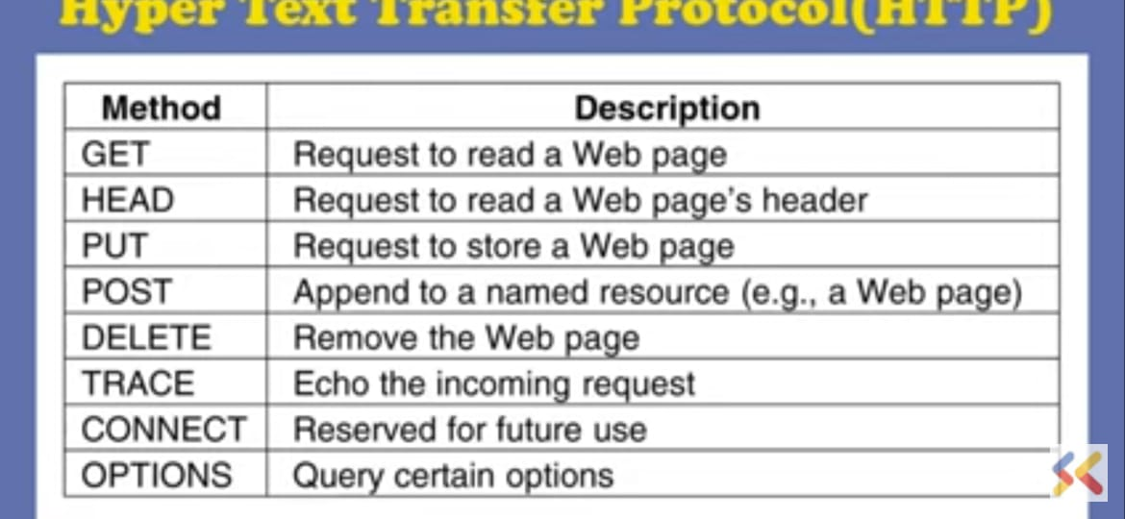
HTTP has many built in functions which allow client system for establishing with a server machine for making a request.

Slide 16
Contd….
Client is sending request to the server…Server is satisfying the client request.. For eg: a browser submits the http request message to view a web page.The server returns the response to the client which includes requested content and status information.

Slide 17
Protocols used in Email
They are
IMAP(Internet Message Address Protocol)
SMTP(Simple Message Transfer Protocol)
POP3(post office protocol version 3)

Slide 18
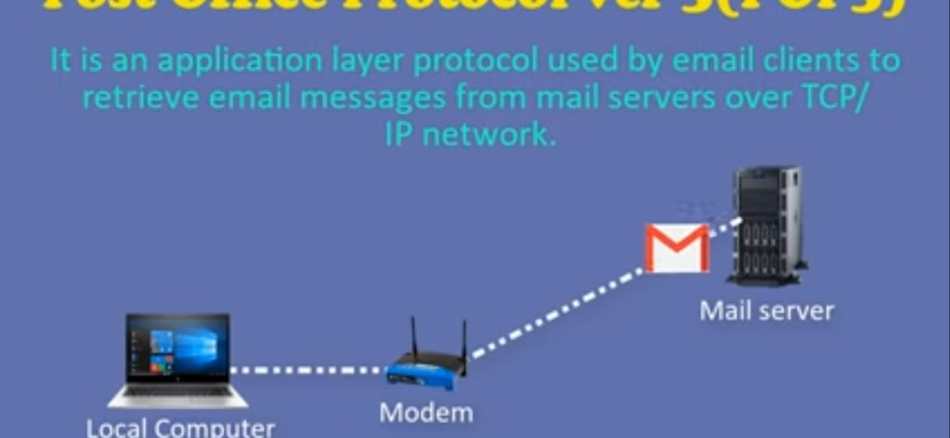
Post Office Protocol ver 3(POP3) It is designed to move the messages from server to local computer.so that the mails can be read even they are not connected to the internet.It supports only one mail server.Port 110-Unsecured email communication.Port 995 –Secure email communication.

Slide 19
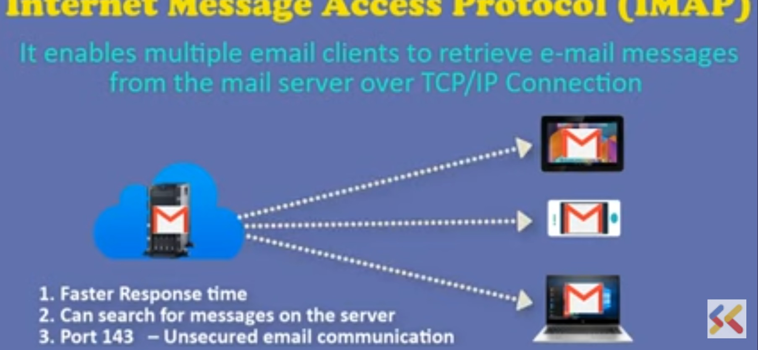
Internet Message Access Protocol(IMAP) 4.Port 993-Encrypted for secured email communication.

Slide 20
Simple Mail Transfer Protocol

